Slide 1
SERVERLESS Planning Poker
Labs 343 Now with more Websockets!
Participants
Architecture
Pricing
Deployment
Questions
Demo

Slide 2
Participants
Brian Dunn
Conner Farris
Joshua Jolley
Monte Moore
Ridzky Riyadi
Ryan Blaser
Participants
Architecture
Pricing
Deployment
Questions
Demo

Slide 3
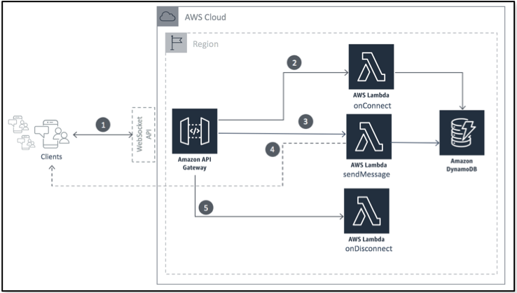
Backend Architecture
Participants
Architecture
Pricing
Deployment
Questions
Demo

Slide 4
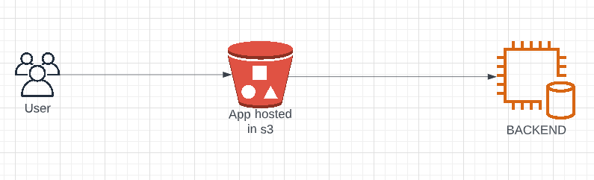
FRONT END Architecture
Participants
Architecture
Pricing
Deployment
Questions
Demo

Slide 5
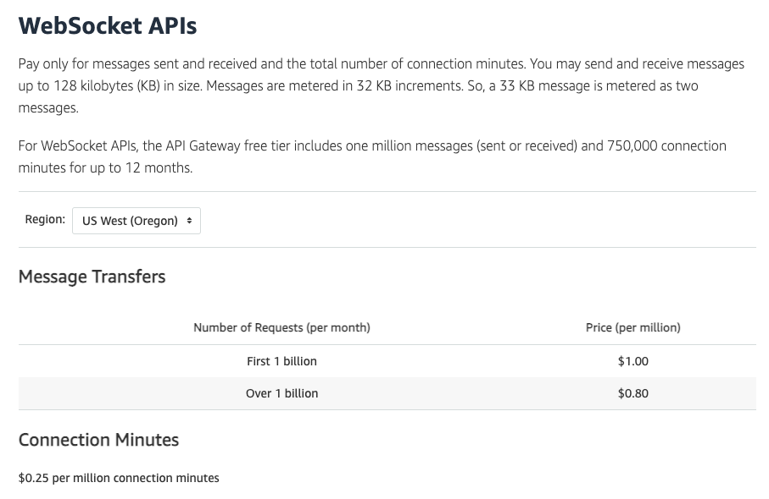
Pricing
API GATEWAY
$1.00 / billion messages + $0.25 /million connection minutes
LAMBDA
$0.0000045 per message
DYNAMODB
$1.25 per million WRU + $0.25 per million RRU
8 PERSON TEAM 1 HR PLANNING COST
2,400 messages ~ $0.0108
480 connection minutes $0.00048
Room DB size 256 bytes $0.00306
Total Cost per planning session
$0.01434
Participants
Architecture
Pricing
Deployment
Questions
Demo

Slide 6
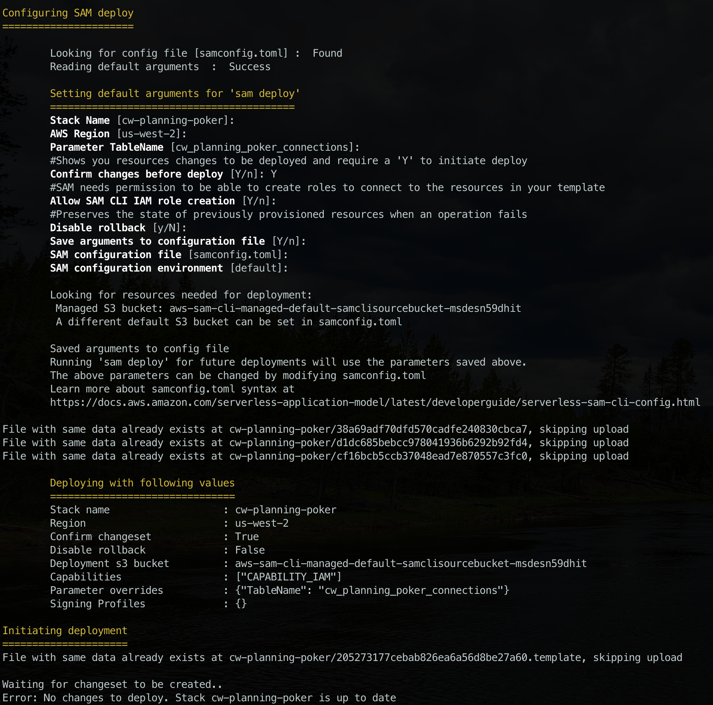
DEPLOYMENT
BACKEND - SAM
FRONTEND - TERRAFORM
Participants
Architecture
Pricing
Deployment
Questions
Demo

Slide 7
Questions?
Participants
Architecture
Pricing
Deployment
Questions
Demo

Slide 8
DEMO
https://cwan-planning-poker.s3.us-west-2.amazonaws.com/index.html
https://stash.arbfund.com/projects/LABS/repos/labs-343/browse
Participants
Architecture
Pricing
Deployment
Questions
Demo

